Slide 1

Azure Databricks

Slide 2
What is Photon?
Photon is a high-performance Azure Databricks-native vectorized query engine that runs your SQL workloads and DataFrame API calls faster to reduce your total cost per workload.
The following are key features and advantages of using Photon.
Support for SQL and equivalent DataFrame operations with Delta and Parquet tables.
Accelerated queries that process data faster and include aggregations and joins.
Faster performance when data is accessed repeatedly from the disk cache.
Robust scan performance on tables with many columns and many small files.
Faster Delta and Parquet writing using UPDATE, DELETE, MERGE INTO, INSERT, and CREATE TABLE AS SELECT, including wide tables that contain thousands of columns.
Replaces sort-merge joins with hash-joins.

Slide 3
Photon: Operators, Expressions and Data types
Operators
Scan, Filter, Project
Hash Aggregate/Join/Shuffle
Nested-Loop Join
Null-Aware Anti Join
Union, Expand, ScalarSubquery
Delta/Parquet Write Sink
Sort
Window Function
Expressions
Comparison / Logic
Arithmetic / Math (most)
Conditional (IF, CASE, etc.)
String (common ones)
Casts
Aggregates(most common ones)
Date/Timestamp
Data types
Byte/Short/Int/Long
Boolean
String/Binary
Decimal
Float/Double
Date/Timestamp
Struct
Array
Map

Slide 4
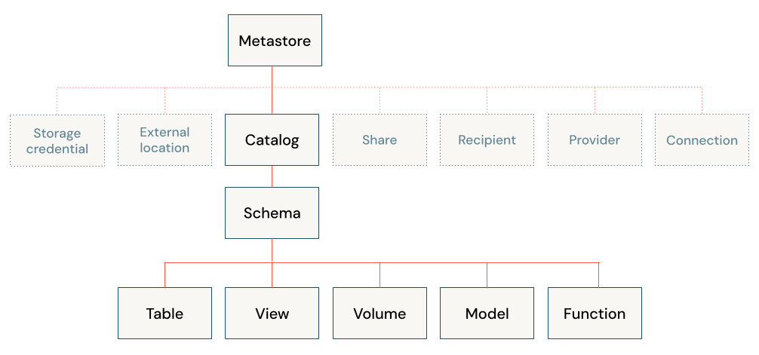
Unity Catalog
Unity Catalog is a fine-grained governance solution for data and AI on the Databricks platform. It helps simplify security and governance of your data by providing a central place to administer and audit data access.
Delta Sharing is a secure data sharing platform that lets you share data in Azure Databricks with users outside your organization. It uses Unity Catalog to manage and audit sharing behavior.

Slide 5
Features of unity catalog
Define Once, Secure Everywhere
Unity Catalog allows you to administer data access policies in a single place, applying them consistently across all workspaces.
Standards-Compliant Security Model
The security model is based on standard ANSI SQL, making it familiar for administrators. You can grant permissions at the level of catalogs, databases (also known as schemas), tables, and views.
Built-In Auditing and Lineage
Unity Catalog automatically captures user-level audit logs, recording data access. It also tracks lineage, showing how data assets are created and used across different languages.
Data Discovery
You can tag and document data assets, and Unity Catalog provides a search interface to help data consumers find relevant data.
System Tables (Public Preview)
Easily access and query operational data, including audit logs, billable usage, and lineage

Slide 6
Platform Administration best practices
Best practice | Impact
Enable Unity Catalog | Data governance: Unity Catalog provides centralized access control, auditing, lineage, and data discovery capabilities across Azure Databricks workspaces.
Use cluster policies | Cost: Control costs with auto-termination (for all-purpose clusters), max cluster sizes, and instance type restrictions. Observability: Set custom_tags in your cluster policy to enforce tagging. Security: Restrict cluster access mode to only allow users to create Unity Catalog-enabled clusters to enforce data permissions.
Use Service Principals to connect to third-party software | Security: A service principal is a Databricks identity type that allows third-party services to authenticate directly to Databricks, not through an individual user’s credentials. If something happens to an individual user’s credentials, the third-party service won’t be interrupted.
Set up SCIM integration | Security: Instead of adding users to Databricks manually, integrate with your identity provider to automate user provisioning and deprovisioning. When a user is removed from the identity provider, they are automatically removed from Databricks too.
Manage access control with account-level groups | Data governance: Create account-level groups so you can bulk control access to workspaces, resources, and data. This saves you from having to grant all users access to everything or grant individual users specific permissions. You can also sync groups from your identity provider to Databricks groups.
Set up IP access for IP whitelisting | Security: IP access lists prevent users from accessing Azure Databricks resources in unsecured networks. Accessing a cloud service from an unsecured network can pose security risks to an enterprise, especially when the user may have authorized access to sensitive or personal data Make sure to set up IP access lists for your account console and workspaces.
Use Databricks Secrets or a cloud provider secrets manager | Security: Using Databricks secrets allows you to securely store credentials for external data sources. Instead of entering credentials directly into a notebook, you can simply reference a secret to authenticate to a data source.
Set expiration dates on personal access tokens (PATs) | Security: Workspace admins can manage PATs for users, groups, and service principals. Setting expiration dates for PATs reduces the risk of lost tokens or long-lasting tokens that could lead to data exfiltration from the workspace.
Use system tables to monitor account usage | Observability: System tables are a Databricks-hosted analytical store of your account’s operational data, including audit logs, data lineage, and billable usage. You can use system tables for observability across your account.

Slide 7
Databricks Compute Best practices
Best Practice | Impact
If you are new to Azure Databricks, start by using general all-purpose instance types | Selecting the appropriate instance type for the workload results in higher efficiency.
Use shared access mode unless your required functionality isn’t supported | Compute with shared access mode can be used by multiple users with data isolation among users.
Use the latest generation instance types if there is enough availability | The latest generation of instance types provide the best performance and latest features.
Set your on-demand and spot-instance balance based on how quickly you need your workload to run | Spot instances save on cost but can affect the overall run time of an operation if the spot instances are reclaimed.
Choose the size of your nodes and the number of workers based on the types of operations your workload performs | For example, if you expect a lot of shuffles, it can be more efficient to use a large single node instead of multiple smaller nodes.
Run vacuum on a cluster with auto-scaling set for 1-4 workers, where each worker has 8 cores. Select a driver with between 8 and 32 cores. Increase the size of the driver if you get out-of-memory (OOM) errors. | Vacuum statements happen in two phases, the second of which is driver-heavy. If you don’t use the right-sized cluster, the operation could cause a slowdown and might not succeed.
Assess whether your batch workflow would benefit from Photon | Photon provides faster queries and reduces your total cost per workload.

Slide 8
Databricks Production job Scheduling best practices
Best Practice | Impact
Use jobs clusters for automated workflows | Cost: Jobs clusters are billed at lower rates than interactive clusters.
Restart long-running clusters | Security: Restart clusters to take advantage of patches and bug fixes to the Databricks Runtime.
Use service principals instead of user accounts to run production jobs | Security: If jobs are owned by individual users, when those users leave the org, these jobs may stop running.
Use Databricks Workflows for orchestration whenever possible | Cost: There’s no need to use external tools to orchestrate if you are only orchestrating workloads on Azure Databricks.
Use latest LTS version of Databricks Runtime | Performance and cost: Azure Databricks is always improving Databricks Runtime for usability, performance, and security.
Don’t store production data in DBFS root | Security: When data is stored in the DBFS root, all users can access it.

Slide 9
Feature Store
A feature store is a centralized repository that enables data scientists to find and share features and also ensures that the same code used to compute the feature values is used for model training and inference.

Slide 10
Why Databricks Feature Store?
Discoverability
The Feature Store UI, accessible from the Databricks workspace, lets you browse and search for existing features.
Lineage
When you create a feature table in Azure Databricks, the data sources used to create the feature table are saved and accessible. For each feature in a feature table, you can also access the models, notebooks, jobs, and endpoints that use the feature.
Integration with model scoring and serving
When you use features from Feature Store to train a model, the model is packaged with feature metadata. When you use the model for batch scoring or online inference, it automatically retrieves features from Feature Store. The caller does not need to know about them or include logic to look up or join features to score new data. This makes model deployment and updates much easier.
Point-in-time lookups
Feature Store supports time series and event-based use cases that require point-in-time correctness.

Slide 11
Working of Databricks Feature Store
Write code to convert raw data into features and create a Spark DataFrame containing the desired features.
For workspaces that are enabled for Unity Catalog, write the DataFrame as a feature table in Unity Catalog. If your workspace is not enabled for Unity Catalog, write the DataFrame as a feature table in the Workspace Feature Store.
Train a model using features from the feature store. When you do this, the model stores the specifications of features used for training. When the model is used for inference, it automatically joins features from the appropriate feature tables.
Register model in Model Registry.

Slide 12
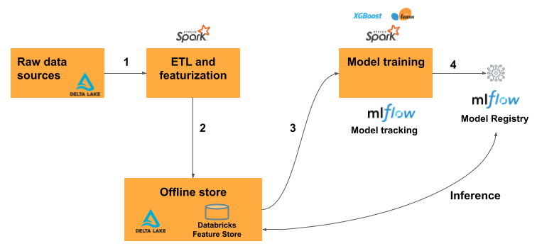
Working of Databricks Feature Store
Write code to convert raw data into features and create a Spark DataFrame containing the desired features.
For workspaces that are enabled for Unity Catalog, write the DataFrame as a feature table in Unity Catalog. If your workspace is not enabled for Unity Catalog, write the DataFrame as a feature table in the Workspace Feature Store.
Train a model using features from the feature store. When you do this, the model stores the specifications of features used for training. When the model is used for inference, it automatically joins features from the appropriate feature tables.
Register model in Model Registry.

Slide 13
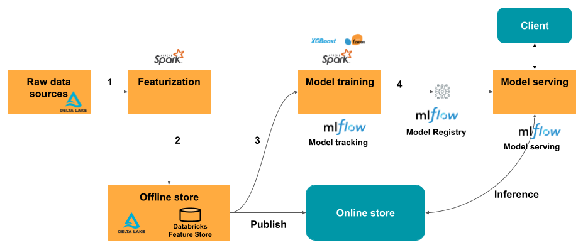
Working of Feature Store
For real-time serving use cases, publish the features to an online store or use an online table.
At inference time, the model reads pre-computed features from the online store and joins them with the data provided in the client request to the model serving endpoint.

